Slide 1


Health Economics Lecture #8
Topic: Measuring Costs and Effects in Economic Evaluation
Prepared by Jacob Smith, Trent University

Slide 2
Learning Objectives
In this lecture we will discuss:
the Quality Adjusted Life Year (QALY)
QALY Measurement: VAS, Standard Gamble and TTO
Data Sources for Economic Evaluation
Goal of this Lecture:
Introduce the concept of the QALY and how it is measured.
Introduce students to data sources for conducting economic evaluation.

Slide 3
Quality Adjusted Life Year (QALY)

Slide 4
The comparability problem in economic evaluation
Economic evaluation is used as a tool for evaluating the cost effectiveness of new drugs or medical interventions.
In the context of cost effectiveness analysis which measures improvement along some medical outcome, the utilization of the computed ICER is impossible to use when comparing other treatments.
i.e. if one treatment is valued in dollars per change in mobility score and another treatment is valued in dollars per change in blood pressure, how do we determine which treatment to fund?
The issue with valuing the cost effectiveness of different interventions is that without a universal measure of health, it is impossible to compare and rank very different treatments.

Slide 5
The Quality Adjusted Life Year
Health Economists solve this issue by using a universal Quality of Life (QoL) index which values the health outcomes in question.
The most popular Quality of Life measurement used in economic evaluation is the Quality Adjusted Life Year (QALY).
The reason why it is powerful is because it values life based on both an individals quality of life at a particular point in time and how long the individual lives in that state.
There is the following saying about QALYs in Economic Evaluation. “A QALY IS A QALY IS A QALY”
This means that regardless of the treatment in question the QALY has the ability to make very different treatments comparable through their index.

Slide 6
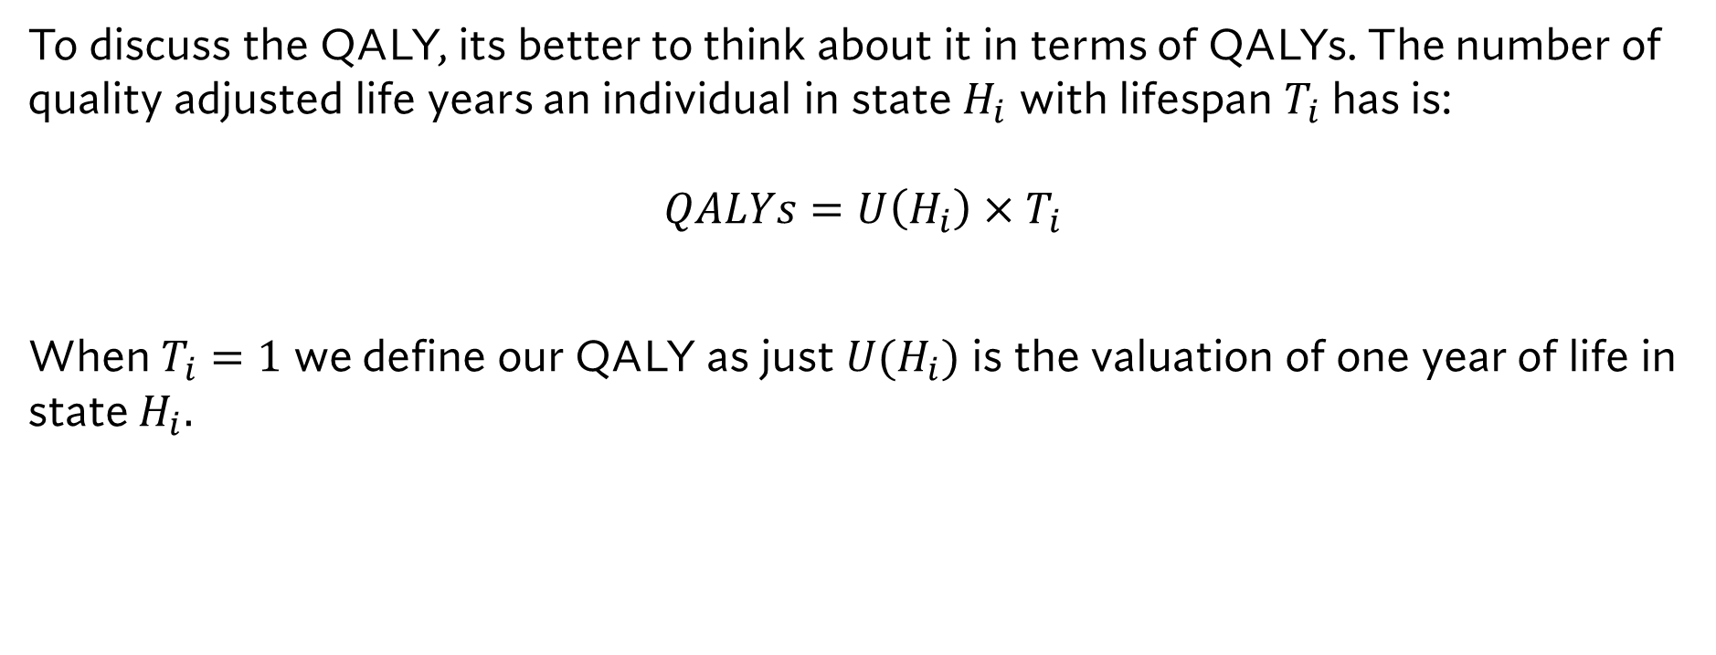
Technical Properties of the QALY
To discuss the QALY, its better to think about it in terms of QALYs. The number of quality adjusted life years an individual in state $H_{i}$ with lifespan $T_{i}$ has is: $$QALYs=U\left(H_{i}\right)×T_{i}$$
When $T_{i}=1$ we define our QALY as just $U(H_{i})$ is the valuation of one year of life in state $H_{i}.$

Slide 7
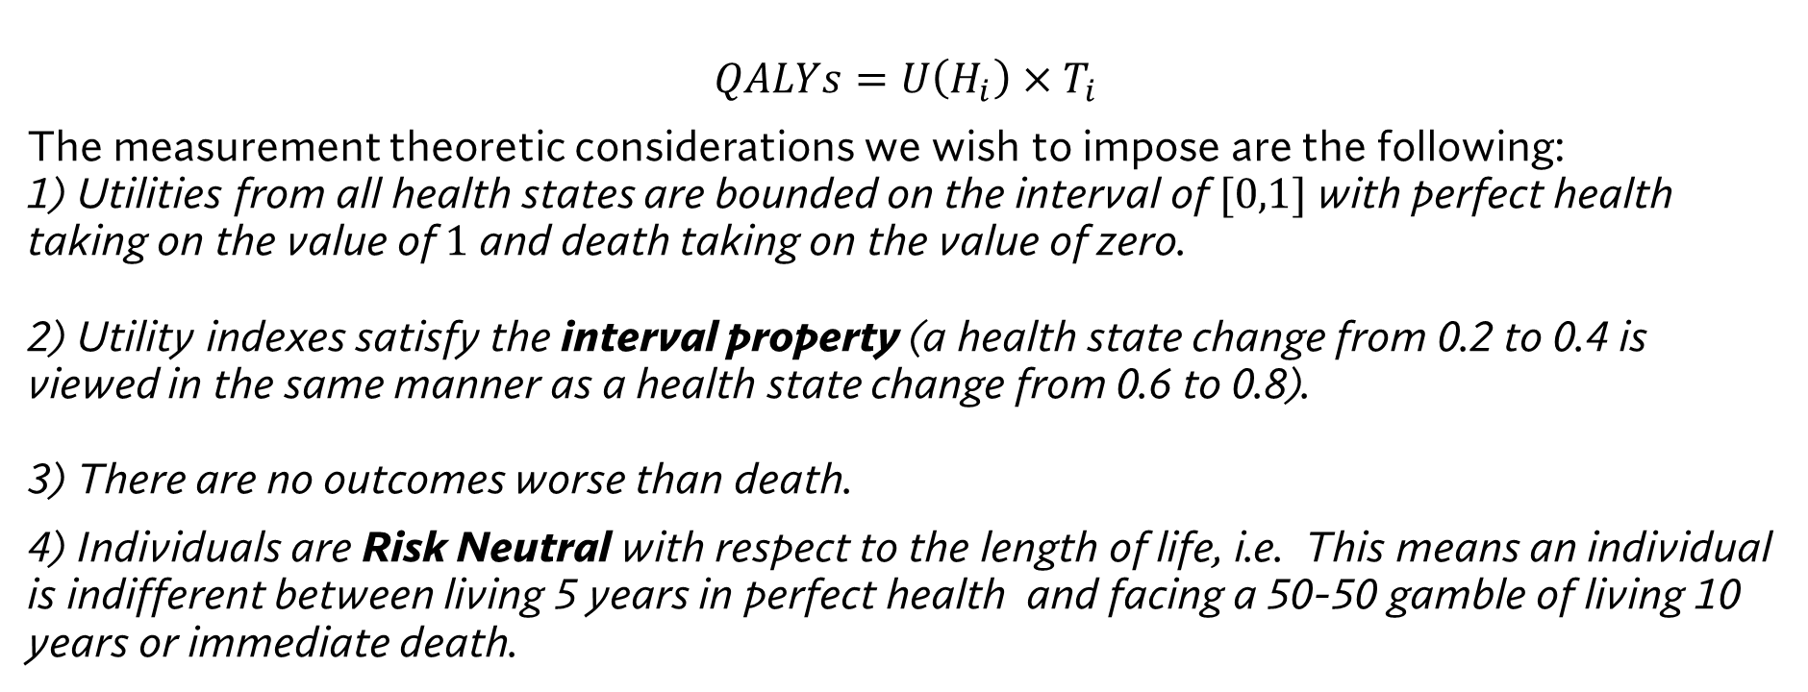
Technical Properties of the QALY
$$QALYs=U\left(H_{i}\right)×T_{i}$$
The measurement theoretic considerations we wish to impose are the following: 1) Utilities from all health states are bounded on the interval of $[0,1]$with perfect health taking on the value of $1$ and death taking on the value of zero. 2) Utility indexes satisfy the interval property (a health state change from 0.2 to 0.4 is viewed in the same manner as a health state change from 0.6 to 0.8). 3) There are no outcomes worse than death.
4) Individuals are Risk Neutral with respect to the length of life, i.e. This means an individual is indifferent between living 5 years in perfect health and facing a 50-50 gamble of living 10 years or immediate death.

Slide 8
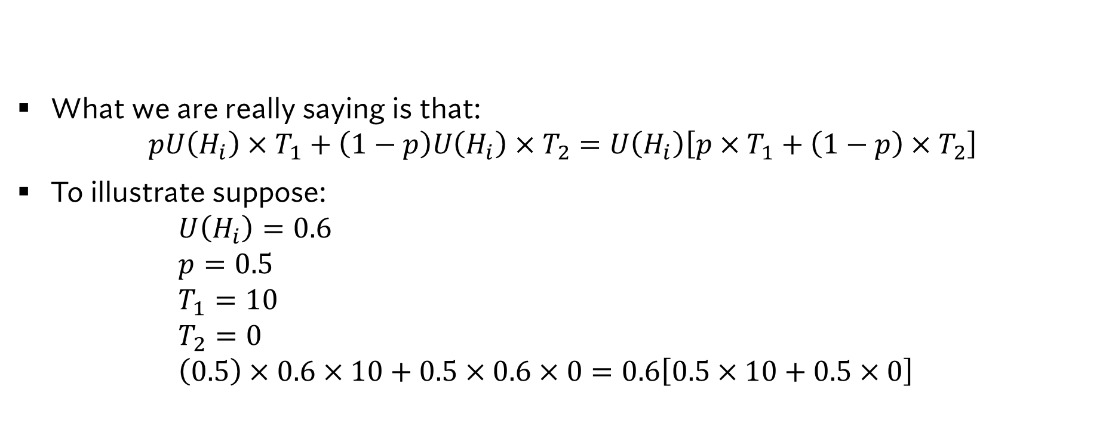
Example of Risk Neturality in Length of Life
What we are really saying is that: $pU\left(H_{i}\right)×T_{1}+\left(1−p\right)U\left(H_{i}\right)×T_{2}=U\left(H_{i}\right)\left[p×T_{1}+\left(1−p\right)×T_{2}\right]$
To illustrate suppose: $U\left(H_{i}\right)=0.6$ $p=0.5$ $T_{1}=10$ $T_{2}=0$ $\left(0.5\right)×0.6×10+0.5×0.6×0=0.6\left[0.5×10+0.5×0\right]$

Slide 9
QALY Measurement: VAS, Standard Gamble and TTO

Slide 10
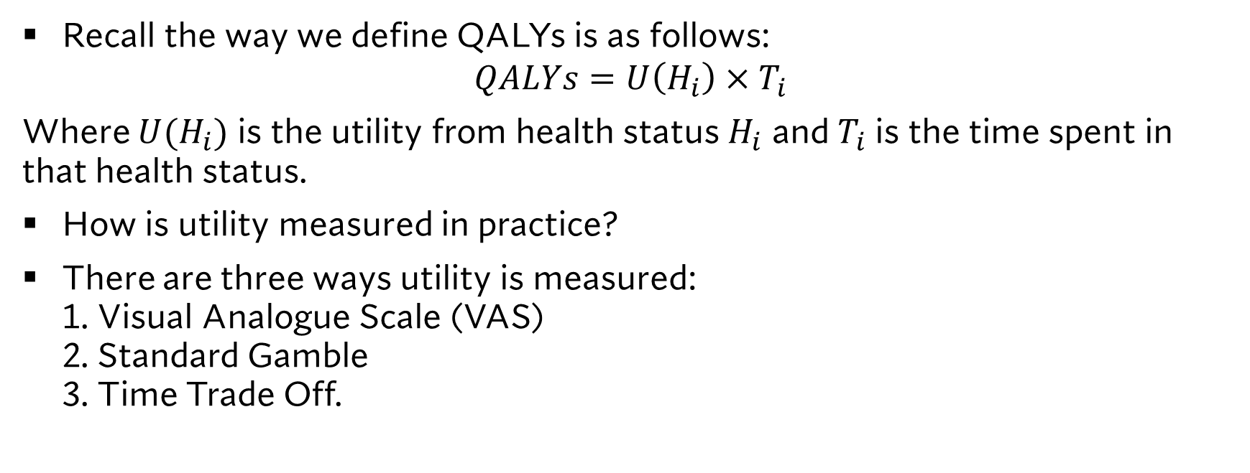
Utility Measurement
Recall the way we define QALYs is as follows:
$$QALYs=U\left(H_{i}\right)×T_{i}$$
Where $U(H_{i})$ is the utility from health status $H_{i}$ and $T_{i}$ is the time spent in that health status.
How is utility measured in practice?
There are three ways utility is measured: 1. Visual Analogue Scale (VAS) 2. Standard Gamble 3. Time Trade Off.

Slide 11
Visual Analogue Scale
To employ the use of the Visual Analogue Scale, patients are simply shown a feeling thermometer and asked how to rank their quality of life.
This method is crude, but it explicitly satisfies the measurement theoretic properties required of QALYs.
Alternatively, this valuation can involve a series of questions and score on a rubric.
0 Worst Imaginable Health State
100 Perfect Health
*To satisfy our measurement properties, we renormalize any score to be on the [0,1] interval

Slide 12
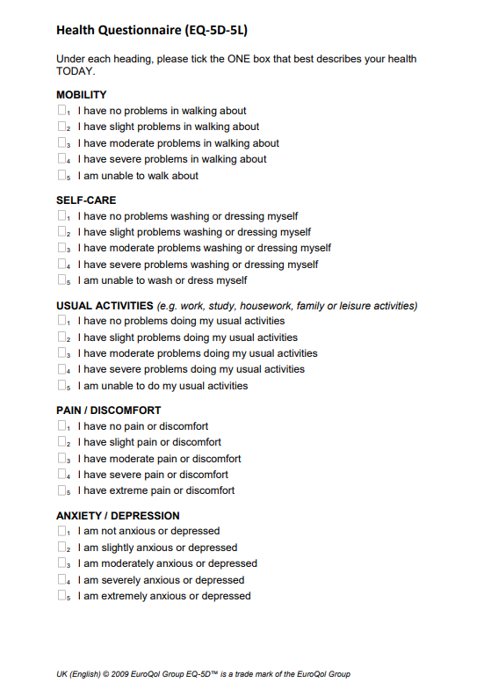
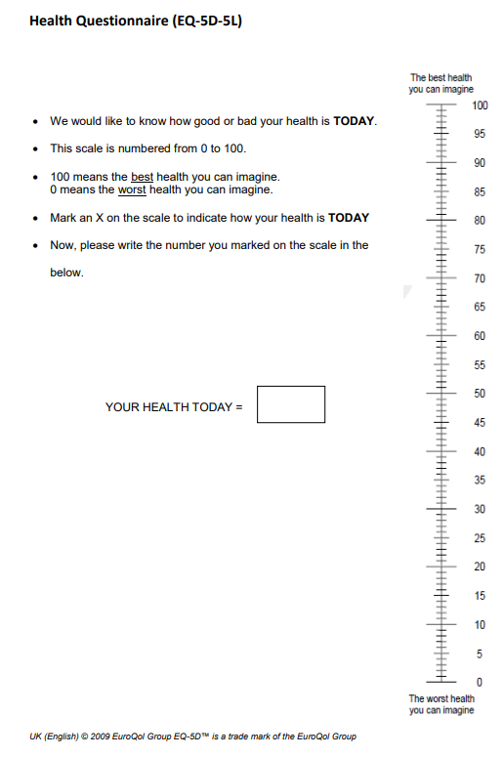
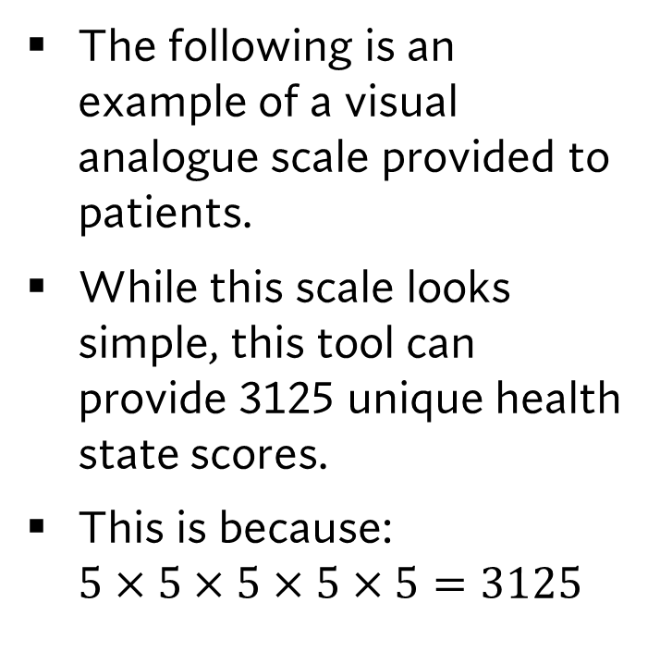
An Example of a VAS: the EQ-5D-5L
The following is an example of a visual analogue scale provided to patients.
While this scale looks simple, this tool can provide 3125 unique health state scores.
This is because: $5×5×5×5×5=3125$

Slide 13
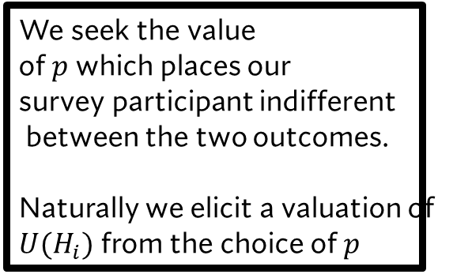






Standard Gamble
Perfect Health
$$p$$
$$U\left(\overline{H}\right)=1$$
We seek the value of $p$ which places our survey participant indifferent between the two outcomes. Naturally we elicit a valuation of $U(H_{i})$ from the choice of $p$
$$1−p$$
Death
$$U\left(\underline{H}\right)=0$$
Health State $i$
$$U(H_{i})$$

Slide 14

Standard Gamble Algebraically
$U\left(H_{i}\right)=pU\left(\overline{H}\right)+\left(1−p\right)U\left(\underline{H}\right)$
We know: $U\left(\overline{H}\right)=1$ $U\left(\underline{H}\right)=0$
This gives us:
$$U\left(H_{i}\right)=p$$

Slide 15

Standard Gamble Algebraically: Back Pain Example
$U\left(H_{i}\right)=pU\left(\overline{H}\right)+\left(1−p\right)U\left(\underline{H}\right)$
We know: $U\left(\overline{H}\right)=1$ $U\left(H_{BP}\right)=0.7$
This gives us:
$$U\left(H_{i}\right)=p+\left(1−p\right)0.7 \\ U\left(H_{i}\right)=p+0.7−p0.7 \\ U\left(H_{i}\right)=0.3p+0.7$$

Slide 16


Standard Gamble: without death
Perfect Health
$$p$$
$$U\left(\overline{H}\right)=1$$
In this case whatever utilities we will measure for $U(H_{i})$ will be on the interval of $\left[0.7,1\right].$
$$1−p$$
Life with Back Pain
$$U\left(\tilde{H}\right)=0.7$$
Health State $i$
$$U(H_{i})$$

Slide 17
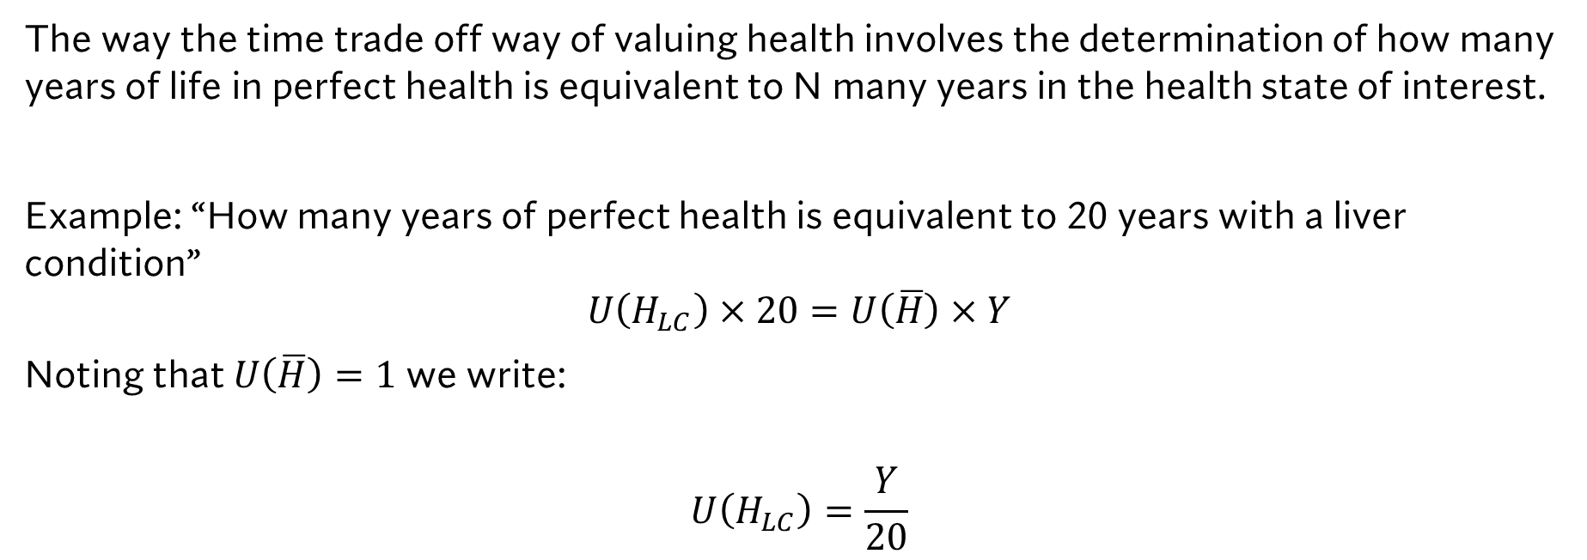
Time Trade Off
The way the time trade off way of valuing health involves the determination of how many years of life in perfect health is equivalent to N many years in the health state of interest.
Example: “How many years of perfect health is equivalent to 20 years with a liver condition”
$$U\left(H_{LC}\right)×20=U\left(\overline{H}\right)×Y$$
Noting that $U\left(\overline{H}\right)=1$ we write:
$$U\left(H_{LC}\right)=\frac{Y}{20}$$

Slide 18
Data Sources for Economic Evaluation

Slide 19
Database for Utilities
In practice analysts do not do primary data collection on patient health status when conducting an a cost effectiveness analysis.
Rather they use knowledge of the clinical pathway and employ the use of supporting literature.
One powerful source for utilities is the CEA REGISTRY by Tufts Center for Evaluation of Risk in Health.

Slide 20
Database for Costs
Obtaining inputs on costs for a cost effectiveness model is more difficult in a global sense.
A useful resource is the CIHI patient cost estimator.
This resource details patient costs for the treatment of 816 distinct hospital-based services based on patient age.

Slide 21
Database for Treatments
When getting started with economic evaluation, it can be difficult to discover drugs to assess.
A good first cut for searching the Canadian Drug Product Database.
This database provides a list of drugs which have applied for approval, rejected and drugs active on the market.
While the documentation appears complex, note that we are just trying to figure out where a drug is used in a clinical pathway.
This is where we get started! Once we have a topic a more thorough search of the literature is necessary.

Slide 22
Summary
With these data sources, the tools needed to develop and conduct economic evaluations of new treatments are in reach!
All we need to know is:
The model structure (Decision tree/Markov model and Transition values).
The costs experienced in each health state.
The defined utilities in each health state.
In general its always a good idea to have some clinical contact to discuss your work with as the strength of your analysis will lie in the proper representation of the clinical pathway.

Slide 23
Learning Objectives
In this lecture we will discuss:
the Quality Adjusted Life Year (QALY)
QALY Measurement: VAS, Standard Gamble and TTO
Data Sources for Economic Evaluation
Goal of this Lecture:
Introduce the concept of the QALY and how it is measured.
Introduce students to data sources for conducting economic evaluation.

